Slide 1

Analyzing Join Dependencies for Fifth Normal Form Decomposition
Database Management System | Database Design and Advanced Normalization
Course: Database Management System | Chapter: Database Design and Advanced Normalization | Program: Bachelor of Engineering
DISCOVER · LEARN · EMPOWER
Notes:
Welcome everyone to today's advanced session on Database Design. We are diving deep into the final frontier of normalization: Fifth Normal Form. This topic is critical for ensuring your database schemas are free from subtle, yet destructive, redundancy. Let us begin our journey into Join Dependencies.

Slide 2
Course Outcomes
SLIDE 2 / 14
Course Outcome
CO | BT LEVEL | DESCRIPTION
CO1 | BT2 | Explain database architecture, relational model concepts and formal query language foundations including relational algebra and relational calculus.
CO2 | BT3 | Apply relational algebra, relational calculus and SQL constructs to formulate correct and efficient database queries.
CO3 | BT4 | Analyze functional dependencies and design normalized relational schemas up to 5NF ensuring lossless join and dependency preservation.
CO4 | BT4 | Analyze transaction schedules and concurrency control mechanisms to determine serializability, recoverability and correctness.
CO5 | BT5 | Evaluate storage structures, indexing strategies and query optimization techniques for performance, scalability and reliability.
Chandigarh University
2 / 14
Notes:
Today's lecture directly addresses our Course Outcomes. CO3 focuses on your ability to design schemas up to 5NF, ensuring they remain lossless and dependency-preserving. CO4 reminds us that while we design for correctness, we must also consider how these structures behave under concurrent transactions. Mastering 5NF is the key to achieving the correctness required by CO4.

Slide 3
Learning Objectives
SLIDE 3 / 14
Learning Outcomes
1
Define Join Dependency and its relationship to Multivalued Dependencies.
2
Analyze the conditions required for a relation to satisfy Fifth Normal Form.
3
Evaluate the necessity of decomposition when a relation violates 5NF.
4
Demonstrate lossless join decomposition using a concrete numerical example.
5
Identify common pitfalls in applying 5NF to real-world schemas.
Chandigarh University
3 / 14
Notes:
By the end of this session, you will be able to define Join Dependency clearly. You will analyze exactly when a relation must be decomposed to satisfy 5NF. We will work through a numerical example to demonstrate the lossless join property. Finally, we will discuss common pitfalls to avoid in your future database designs.

Slide 4
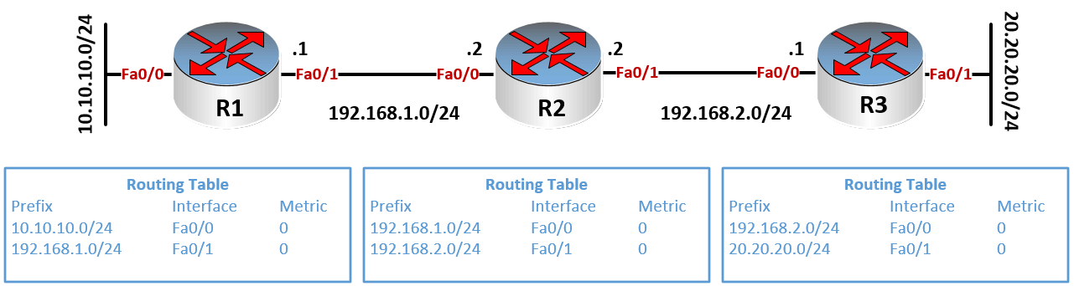
Lecture
SLIDE 4 / 14
Understanding Join Dependencies
1
A Join Dependency (JD) holds if a relation equals the join of its projections.
2
JD is denoted as ⊳◁(R1, R2, ..., Rn) for a relation R decomposed into subsets.
3
Every relation satisfies the trivial JD where projections are the relation itself.
4
Non-trivial JDs imply the relation can be reconstructed from smaller tables.
5
5NF requires that every non-trivial JD is implied by candidate keys.
6
JDs generalize Multivalued Dependencies (MVDs) to three or more attributes.
Split Horizon: Tutorial & Examples
Chandigarh University
4 / 14
Notes:
Think of a Join Dependency as a promise that a table can be perfectly reconstructed from its parts. If you split a table and join the parts back, you should see no spurious rows. This concept generalizes MVDs, which only handle two-way splits, to complex multi-way splits. In 5NF, we demand that these splits are only valid if they are forced by the keys.

Slide 5
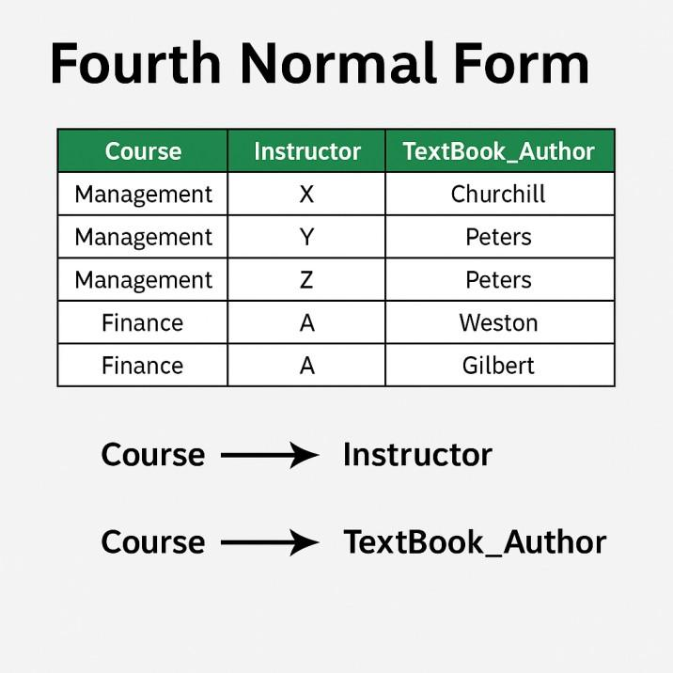
Lecture
SLIDE 5 / 14
The Fifth Normal Form Definition
1
A relation is in 5NF if every non-trivial JD is implied by candidate keys.
2
5NF eliminates redundancy caused by complex interdependencies between attributes.
3
A relation in 5NF is also in 4NF, 3NF, and BCNF.
4
Decomposition into 5NF must be lossless to preserve data integrity.
5
Dependency preservation is often sacrificed in 5NF decompositions.
6
5NF is the highest level of normalization for relational schemas.
Source: media.geeksforgeeks.org
Chandigarh University
5 / 14
Notes:
The definition of 5NF is strict: every join dependency must be a consequence of the candidate keys. If a join dependency exists that is not implied by a key, the relation is not in 5NF. This form eliminates redundancy that lower normal forms cannot catch. However, achieving 5NF often means we sacrifice dependency preservation for the sake of eliminating anomalies.

Slide 6
Lecture
SLIDE 6 / 14
Relationship with Multivalued Dependencies
1
MVDs are a special case of Join Dependencies involving only two projections.
2
If a relation has an MVD, it automatically satisfies a specific JD.
3
4NF eliminates non-trivial MVDs that are not implied by keys.
4
5NF eliminates non-trivial JDs that are not implied by keys.
5
A relation in 5NF is guaranteed to be in 4NF.
6
JDs allow for decompositions into three or more relations simultaneously.
Chandigarh University
6 / 14
Notes:
It is crucial to understand that MVDs are just a specific type of Join Dependency. If you have a multivalued dependency, you inherently have a join dependency. 4NF handles the two-way splits, but 5NF handles the complex three-way or four-way splits. If a relation is in 5NF, it is automatically in 4NF, but the reverse is not true.

Slide 7
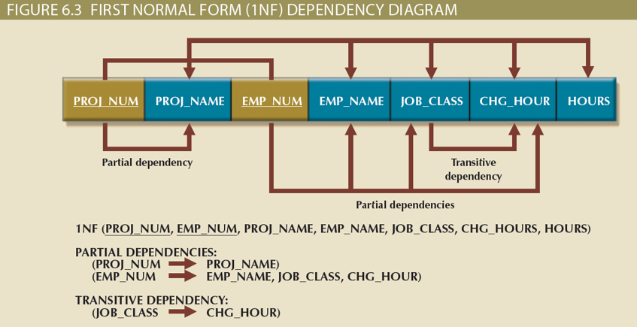
Worked Example
SLIDE 7 / 14
Supplier-Project-Part Scenario
CONSTRAINTS
Supplier S supplies Part P to Project J.
THIS CREATES A NON-TRIVIAL JD
⊳◁(SP, PJ, JS).
• Consider a relation R(Supplier, Project, Part) with no candidate keys.
• Constraint 1: If S supplies P, S can supply P to any project.
• Constraint 2: If S supplies P to J, S can supply P to any project.
• Constraint 3: If S supplies P to J, S can supply P to any project.
Source: media.cheggcdn.com
Chandigarh University
7 / 14
Notes:
Let's look at a classic example: Suppliers, Projects, and Parts. Suppose a supplier can supply a part to a project. If Supplier A supplies Part X to Project 1, and also supplies Part X to Project 2, does that mean they supply Part X to all projects? Not necessarily. This creates a complex dependency where the join of three projections is required to reconstruct the original data without spurious rows.

Slide 8
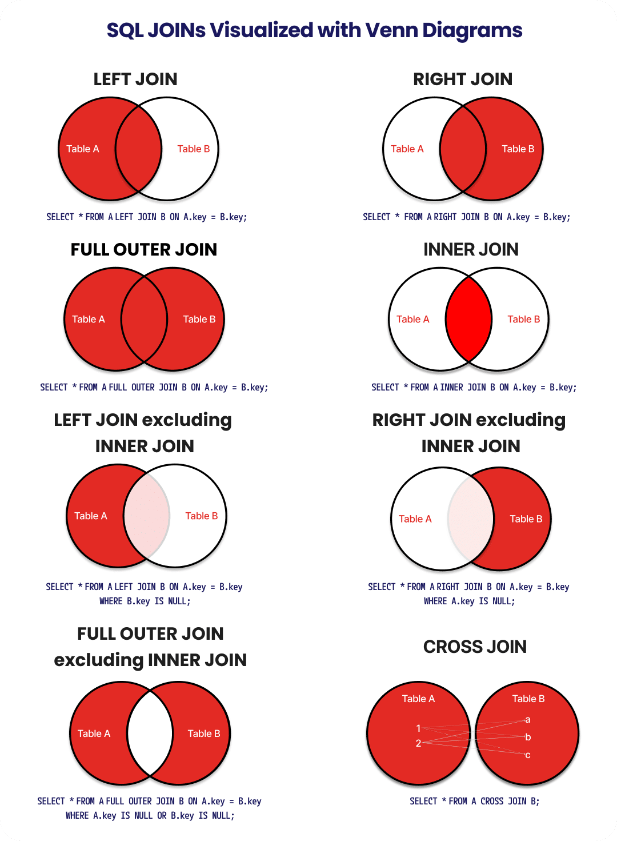
Lecture
SLIDE 8 / 14
Numerical Analysis of the Example
ORIGINAL DATA
(S1, P1, J1), (S1, P1, J2), (S1, P2, J1).
• Decompose into R1(S, P), R2(P, J), R3(S, J).
• Join R1 and R2: (S1, P1, J1), (S1, P1, J2), (S1, P2, J1), (S1, P2, J2).
• Spurious row (S1, P2, J2) appears in the join result.
• This spurious row violates the original business constraint.
• The relation is not in 5NF due to this non-trivial JD.
Source: red9.com
Chandigarh University
8 / 14
Notes:
Let's do the math. If we join the decomposed tables, we get a spurious row: Supplier 1 supplying Part 2 to Project 2. This row was not in the original data. This proves the original relation was not in 5NF. The join dependency was not implied by any key, leading to data anomalies. We must decompose further to remove this redundancy.

Slide 9

Lecture
SLIDE 9 / 14
Decomposition Process for 5NF
1
Identify the non-trivial Join Dependency causing the anomaly.
2
Decompose the relation into projections corresponding to the JD components.
3
Verify that the decomposition is lossless using the chase algorithm.
4
Check if the new relations satisfy 5NF independently.
5
Repeat the process until all relations are in 5NF.
6
Ensure the join of all new relations reconstructs the original data.
Source: Wikipedia — Object co-segmentation (CC BY-SA)
Chandigarh University
9 / 14
Notes:
To fix this, we decompose the relation into three smaller tables: Supplier-Part, Part-Project, and Supplier-Project. Each of these tables represents a projection of the original relation. We verify that joining them back together reconstructs the original data exactly, without any spurious rows. This process ensures that the redundancy is eliminated.

Slide 10
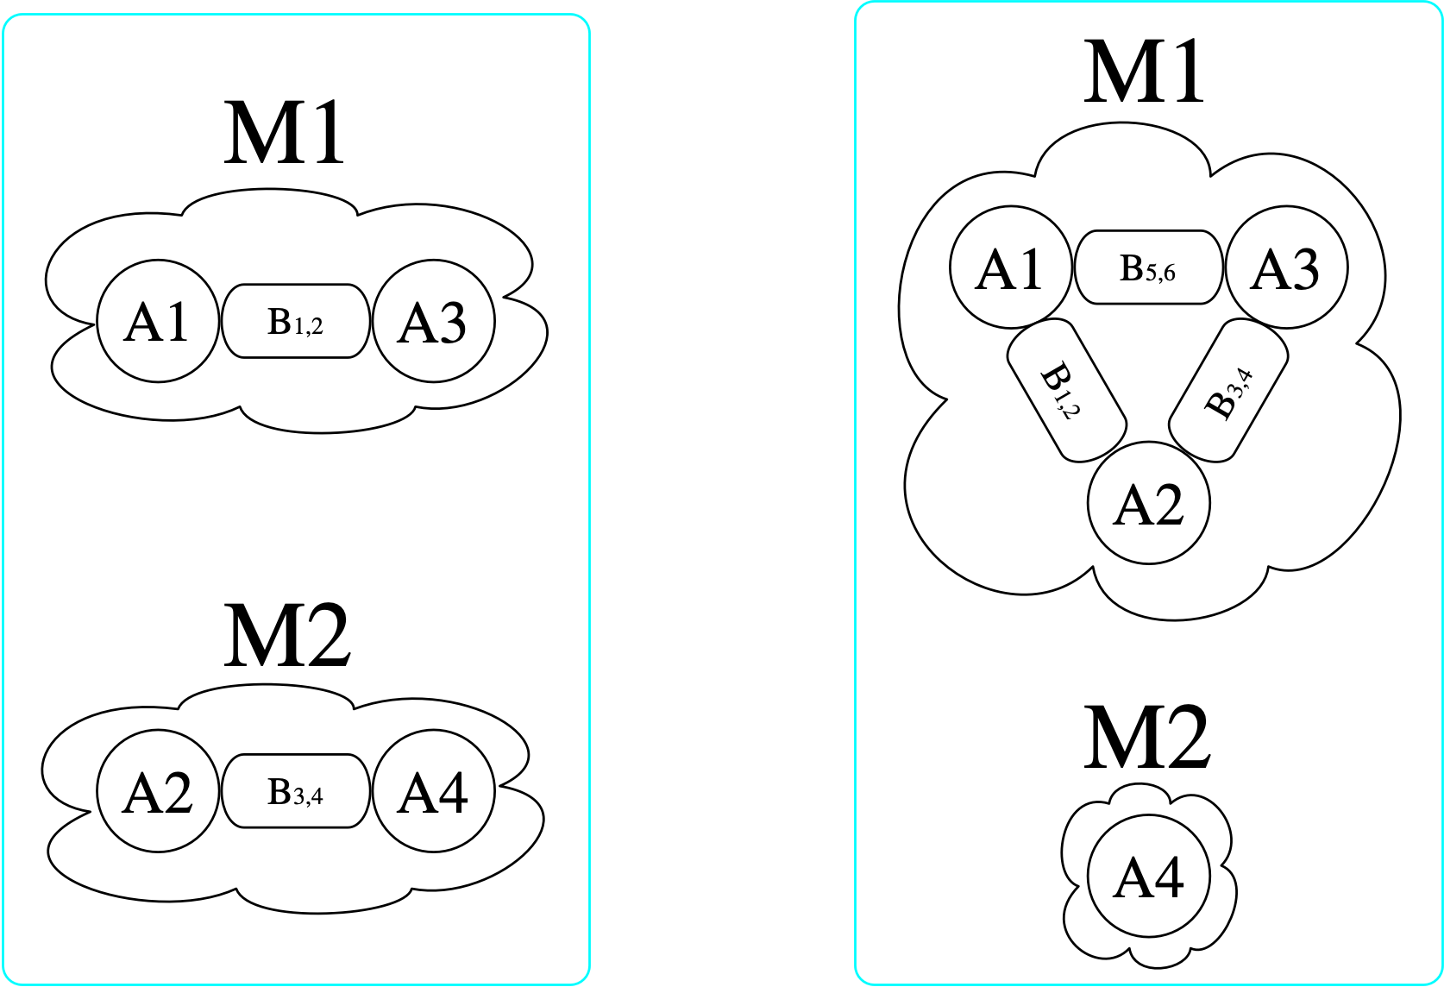
Lecture
SLIDE 10 / 14
Lossless Join Property Verification
1
A decomposition is lossless if the natural join equals the original relation.
2
Use the chase algorithm to verify lossless join for JDs.
3
If the intersection of projections contains a key of one projection, it is lossless.
4
For 5NF, the join of all decomposed relations must equal the original.
5
Lossless join ensures no data is lost or duplicated during reconstruction.
6
This property is mandatory for any valid 5NF decomposition.
Source: blog.algebraicjulia.org
Chandigarh University
10 / 14
Notes:
The lossless join property is non-negotiable. If we decompose a table, we must be able to get it back exactly. We use the chase algorithm to verify this. If the intersection of the decomposed tables contains a key, the join is guaranteed to be lossless. This ensures that our normalization process does not destroy data integrity.

Slide 11
Lecture
SLIDE 11 / 14
Dependency Preservation in 5NF
1
5NF decompositions often sacrifice dependency preservation.
2
Functional dependencies may not hold in the decomposed relations.
3
Checking constraints may require joining multiple tables.
4
This increases query complexity and performance overhead.
5
Designers must weigh redundancy reduction against query performance.
6
Sometimes, denormalization is preferred for performance in 5NF scenarios.
Chandigarh University
11 / 14
Notes:
Here is a trade-off: achieving 5NF often means we lose dependency preservation. We might have to join multiple tables to check a constraint that was simple in the original table. This increases query complexity. Designers must decide if the reduction in redundancy is worth the performance cost. Sometimes, a slight denormalization is the better engineering choice.

Slide 12
Lecture
SLIDE 12 / 14
Common Pitfalls in 5NF Design
OVER-NORMALIZING
Decomposing relations that are already in 5NF unnecessarily.
IGNORING SPURIOUS TUPLES
Failing to check for join anomalies.
NEGLECTING PERFORMANCE
Forgetting the cost of multi-way joins.
MISIDENTIFYING KEYS
Failing to find the true candidate keys.
FORGETTING TRIVIAL JDS
Not recognizing when a JD is trivial.
• Assuming 4NF implies 5NF: They are distinct normalization forms.
Chandigarh University
12 / 14
Notes:
Be careful not to over-normalize. Just because a relation is in 4NF doesn't mean it's in 5NF. A common pitfall is assuming that all join dependencies are trivial. You must rigorously check for spurious tuples. Also, remember that every join operation has a cost. Don't normalize a table just for the sake of it if it hurts performance.

Slide 13
Lecture
SLIDE 13 / 14
Key Takeaways
1
Join Dependency generalizes MVDs to three or more attribute sets.
2
5NF requires all non-trivial JDs to be implied by candidate keys.
3
Decomposition must be lossless to ensure data integrity.
4
5NF often sacrifices dependency preservation for redundancy elimination.
5
Always verify for spurious tuples when decomposing relations.
Chandigarh University
13 / 14
Notes:
To summarize, Join Dependencies are the key to understanding 5NF. They generalize MVDs to complex scenarios. Remember that 5NF requires these dependencies to be implied by keys. While this eliminates redundancy, it often comes at the cost of dependency preservation. Always verify your decompositions for lossless joins.

Slide 14
Lecture
SLIDE 14 / 14
References
1
Fundamentals of Database Systems — Ramez Elmasri & Shamkant B. Navathe
2
Database System Concepts — Silberschatz, Korth & Sudarshan
3
Database Management Systems — Raghu Ramakrishnan & Johannes Gehrke
4
Oracle/MySQL Documentation — Oracle
Chandigarh University
14 / 14
Notes:
For further reading, I recommend the standard texts by Elmasri and Navathe, as well as Silberschatz. Ramakrishnan's book provides excellent practical insights. Finally, consult the Oracle and MySQL documentation for specific implementation details. Thank you for your attention, and I am now open to your questions.

